Slide 1


NDR

Slide 2
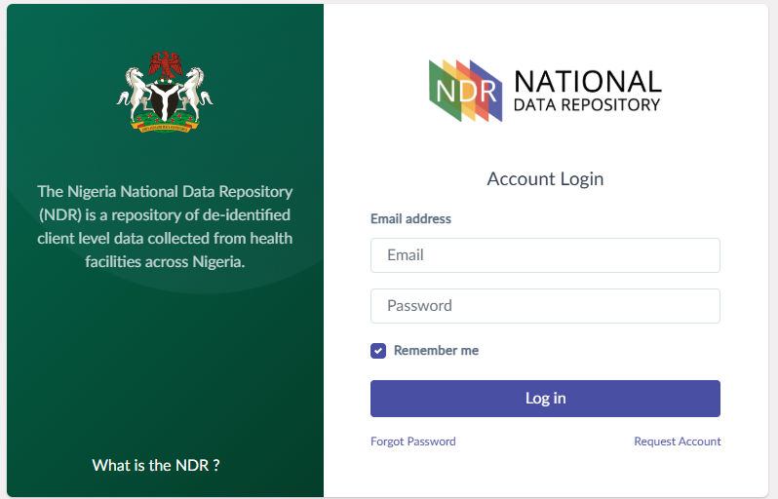
How to Login to NDR
NDR URL:
https://ndr.nascp.gov.ng
​Steps to log in to the National Data Repository (NDR)
Enter your email address​
Enter your password
After entering your credentials, click the Login button to access your account.

Slide 3
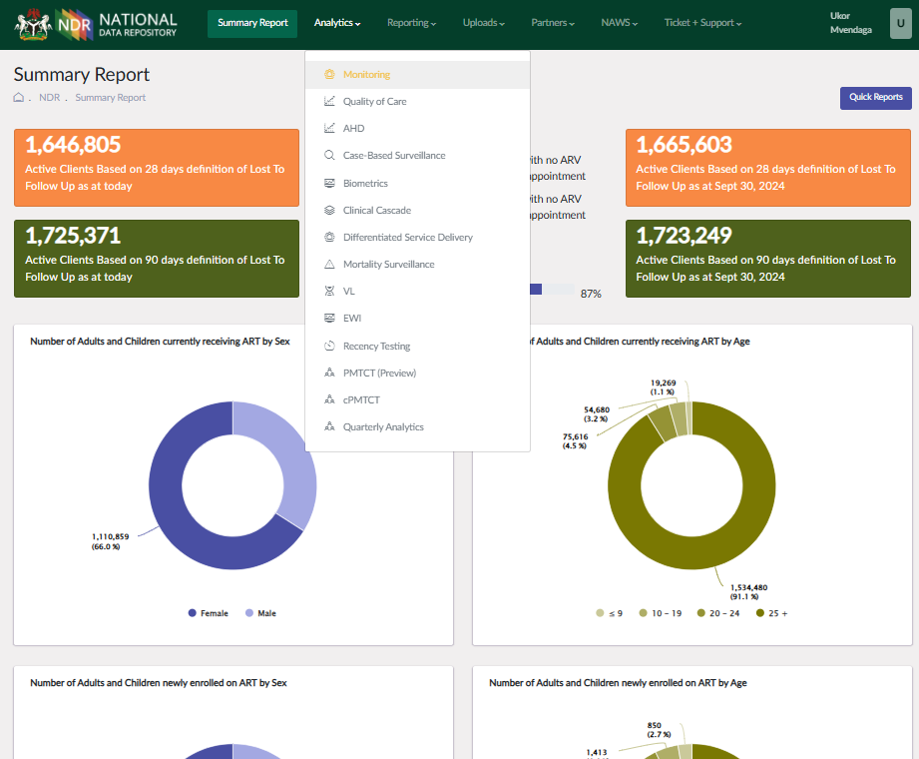
How to Get Treatment Data
To access Treatment Data
Navigate to the menu bar, click on “Analytics”, then select “Monitoring”.

Slide 4
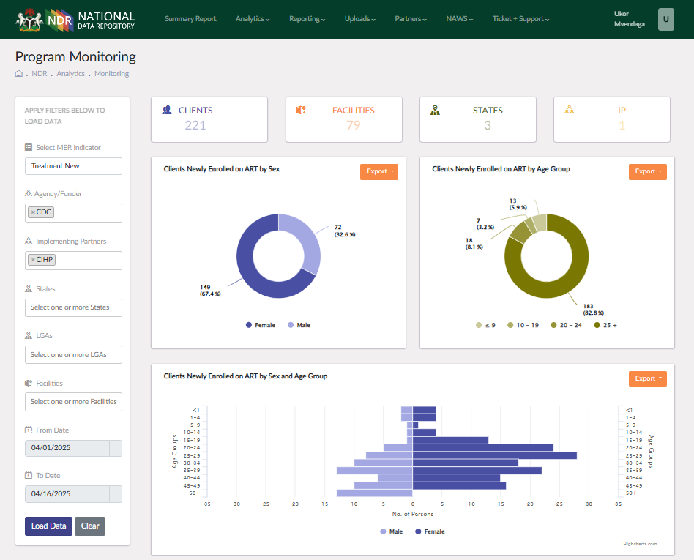
How to Get Treatment Data
You can apply filters to view indicators such as TX_NEW, TX_CURR, TX_PVLS, and HTS_TST by Implementing Partner (IP), State, LGA, Facility, and Date Range.

Slide 5
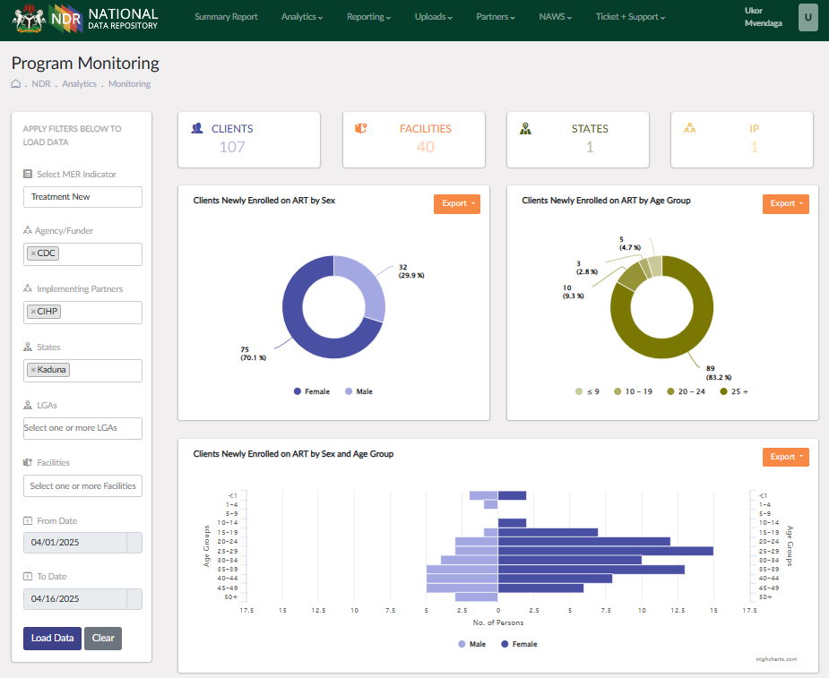
TX_NEW Data by State
Dashboard showing Tx_New data by state

Slide 6
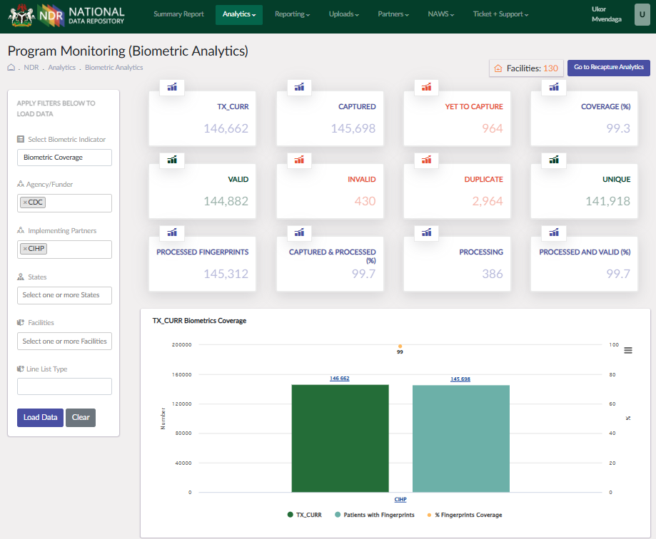
How to View Biometrics Data
To access Biometrics Data
Navigate to the menu bar, click on “Analytics”, then select “Biometrics”.
Biometric Dashboard

Slide 7
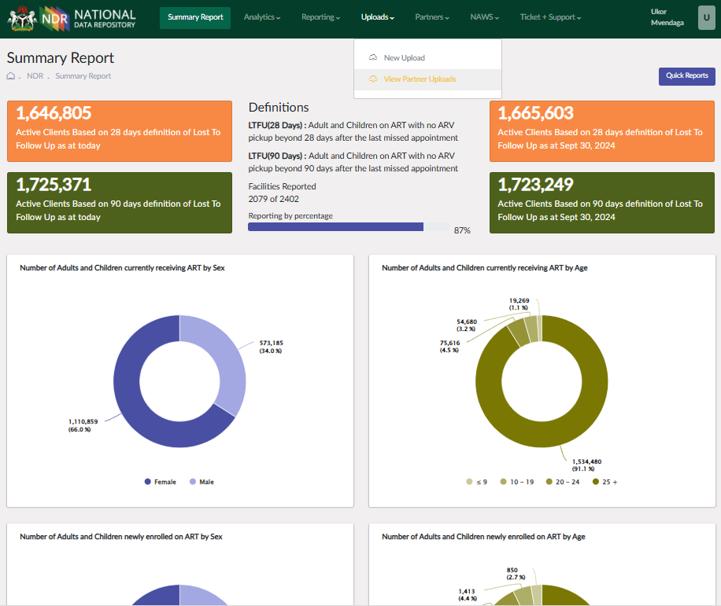
How to View Uploads on NDR
To view Uploads on NDR
Navigate to the menu bar, click on “Uploads”, then select “View Partner Uploads”.

Slide 8
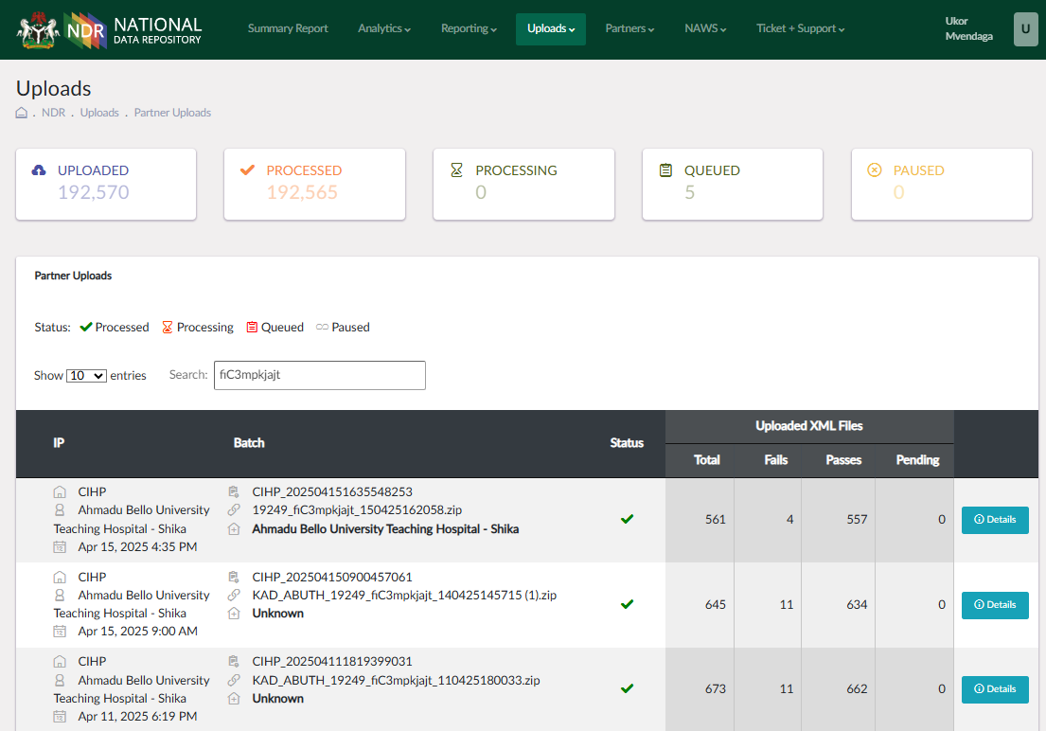
How to View Uploads on NDR
To view the most recent uploads, select the number of entries (10, 50, or 100).
Uploads Dashboard

Slide 9
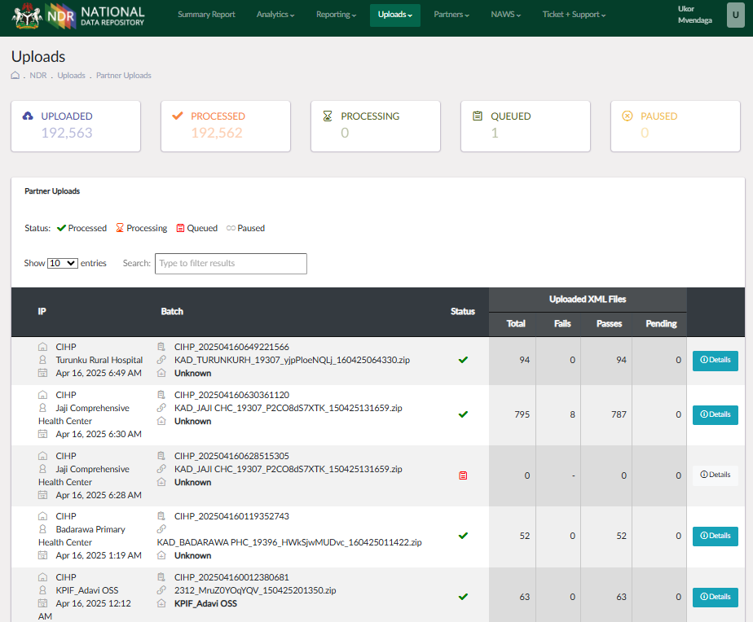
View Uploads on NDR Using Facility Datim Code
Input the facility DATIM code in the search box and allow it to load. You will see the Batch ID, Status, Total, Fails, Passes, and Pending.
To view the upload details for that batch, click on “Details.”

Slide 10
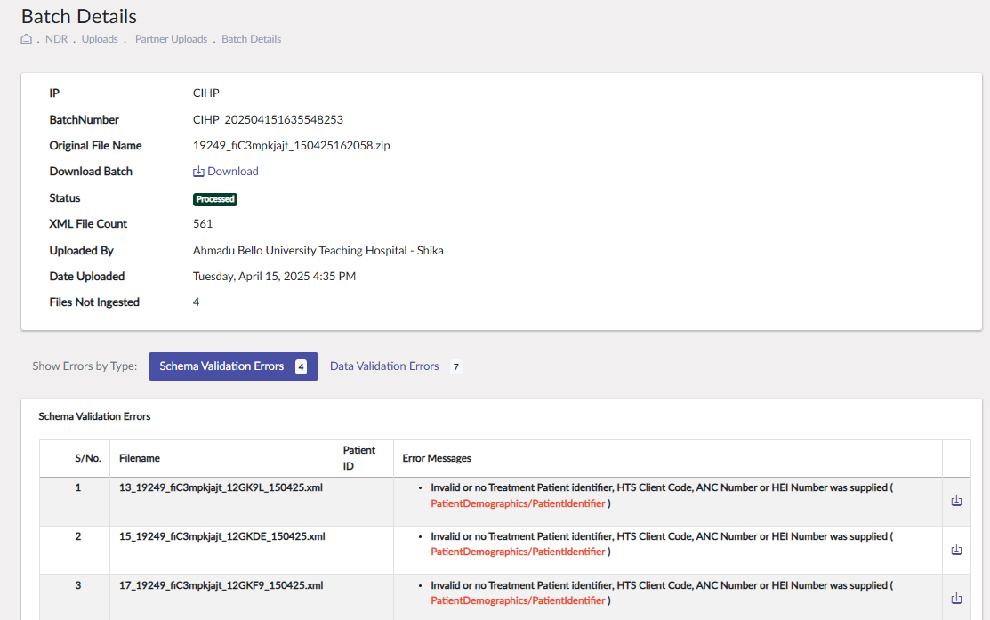
Batch Details
Batch Details Dashboard

Slide 11
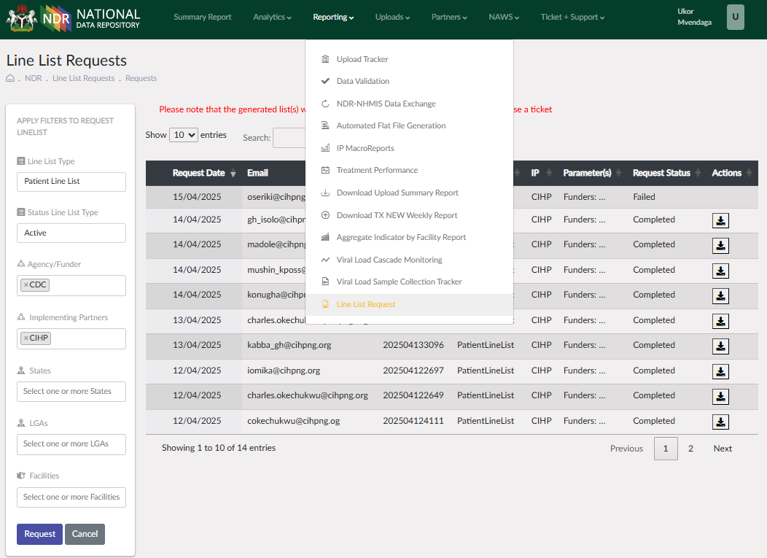
How to Generate Line List
To view generate line list
Navigate to the menu bar, click on “Reporting”, then select “Line List Request”.
To download the generated line list, an email will be sent to you, or you can refresh the page. Once it is available, click the download icon under Actions to save it to your computer.

Slide 12

Thank
You
People. Partnerships. Systems

